Slide 1
Statistical Plots
Lesson 5 Hands-On
Alison Schnoes

Slide 2
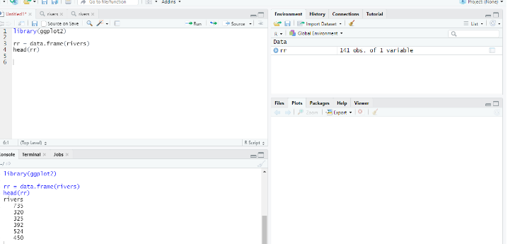
Firstly
We must make sure that we are using the correct library and data set.

Slide 3
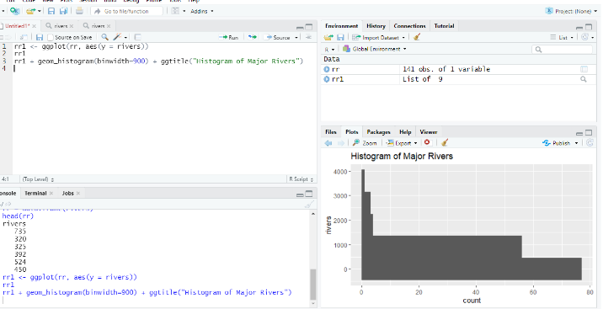
Histogram
Code & Graph

Slide 4
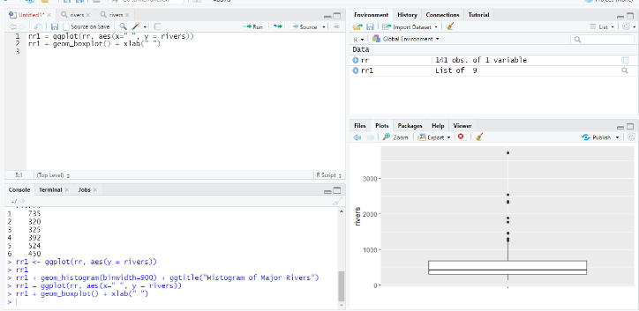
Box Plot
Code & Graph

Slide 5
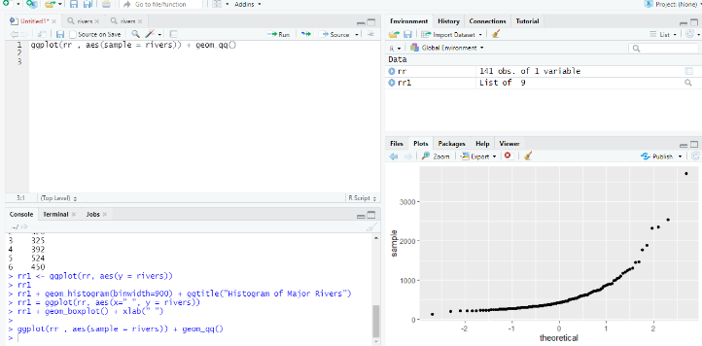
Normal Probability Plot
Code & Graph

Slide 6
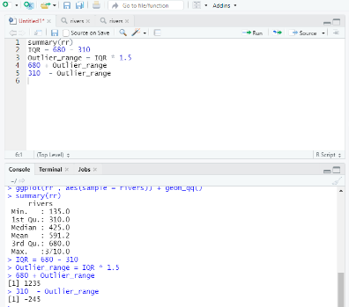
Mathematically screen for outliers
Code

Slide 7
Answer Questions
Are there any outliers in this data set? Are they high or low outliers?
Yes there are outliers
There are high and low
Do these data appear to come from a normal distribution?
No - these are not equal
Median : 425.0
Mean : 591.2

